Slide 1


BioSecurity3.0
Web-Based Access Control Software

Slide 2
BioSecurity3.0
BioSecurity3.0 is the ultimate “All-in-One” solution which offers a complete security management platform.
It comes with four integrated modules:
access control, visitor management,
elevator control, and video linkage.
One Platform
www.zkteco.me

Slide 3
Features
Web-Based Access Control Software
Data Auto-Backup Function
“All-in-One” Solution
Support 3rd Party Device
Many Doors Management Capacity
Attendance Calculation and Reports
Global Anti-Passback and Linkage
Huge Data Processing Capability
Neat and Tidy, Simple & User-Friendly UI
E-mail Notifications
www.zkteco.me

Slide 4
Specifications
Item | Description
System Architecture | Server/Browser
Database | PostgreSQL
Supported Operating Systems | Windows 7/Windows 8/Windows 8.1/Windows Server 2008(32/64).
Recommended Browser Version | IE 11+/Firefox 27+/Chrome 33+
Software Capacity | Allows management of data for 30,000 people. Up to 50 pull devices or 500 Push devices in Single Server UP to 2000 push devices in Multi-Server
Function Modules | personnel, Access, Elevator, Visitor, Video Linkage
Personnel Management | Disable person; Valid time; Delay passage; Duress fingerprint, Export/import; Batch issue card; Reports and so on.
Access Control | Time period; Holiday; Access levels; First-person normally open; Multi-person group; Zone define; Reader define; Who is inside; Global Anti-passback; Global linkage; Real-time monitoring
Elevator Control | Time period; Holiday; Elevator levels; Real-time monitoring; Linkage
Visitor | Reservation; Visitor levels; Person Self-login
Video Linkage | Support Video Devices: ZKTeco brand;HIKvision:IPC/DVR/NVR DS series.

Slide 5
Web-Based Platform
One platform
Multi-Application
Access control
Device
Elevator
Common Platform
Personnel, Card
first stage
(available)
Visitor
system management
+
Video linkage
Docking with the third-party system:
OA、CRM、ERP…
ONVIF
second stage
T&A
www.zkteco.me

Slide 6
BioSecurity3.0 Architecture Design
Common business database
Access Database
Elevator Database
Visitor Database
Video Database
BioSecurity Application & Service integrative platform
Business Logic Module
Personnel
Access
Elevator
Visitor
Video
Common business process engine
Login control center
Application authorization center
Smart Web server develop
Service Registry
Information mining
software licensing
authorization check
Page-Based Configuration
service monitoring
system parameter
APP licensing
Modify take effect immediately
Service Test
Health monitors
Device management
Data processing engine
Device driver
P2P
Data Analysis
rules conversing
Message adapter in the middle
Message publish/subscribe
Message validation verification
Message route
ADMS Message Middleware

Slide 7
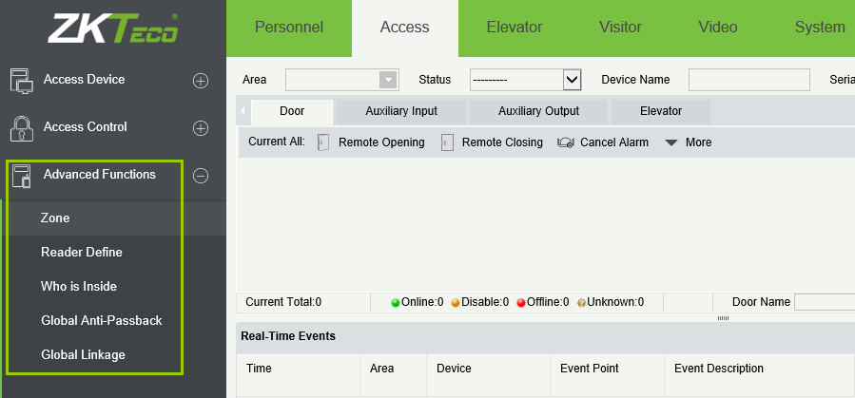
Access Control Management
www.zkteco.me

Slide 8

BioSecurity3.0
Massive Door Capacity
Global Anti-Pass back & Linkage
Up to 2,000 doors in single server and 8,000 in multi-server
www.zkteco.me

Slide 9



Visitor Management
Step One
Step Two
Visitor Management module that supports Emirates ID, etc.
Registration
Flexible Privilege Control
www.zkteco.me

Slide 10
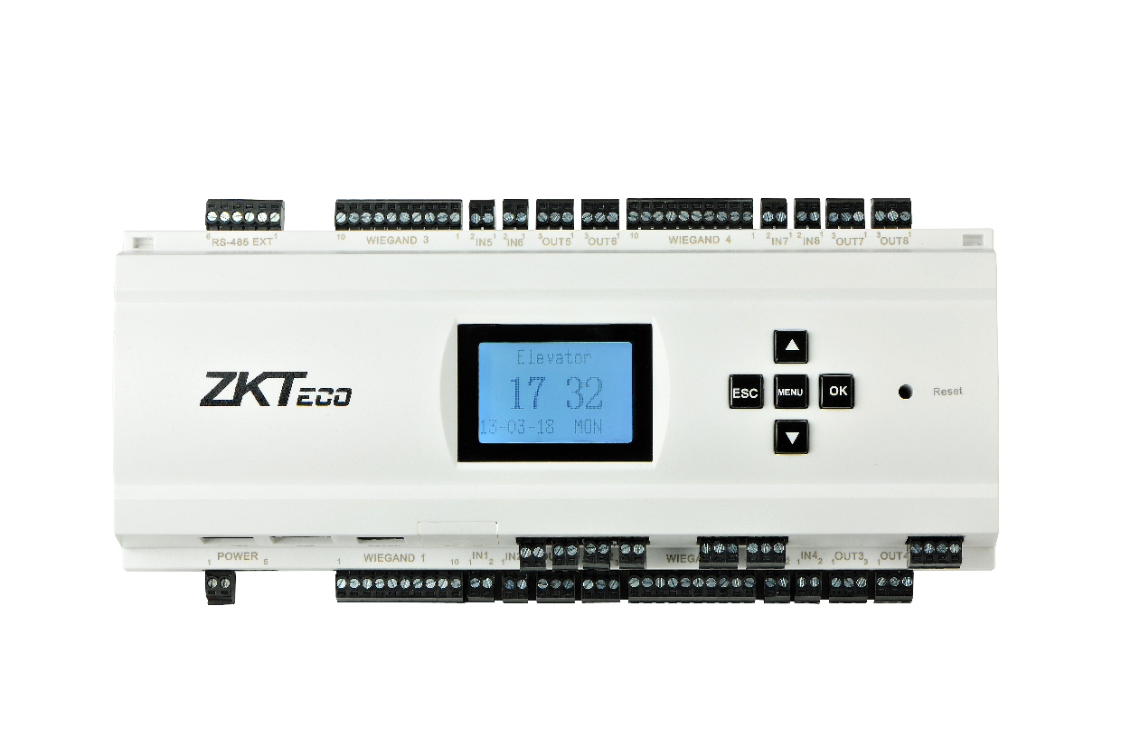
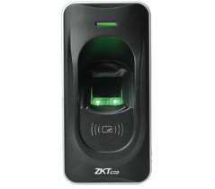
Elevator Control
Remote control elevator buttons;
The Elevator and video linkage;
Various reports.
www.zkteco.me

Slide 11
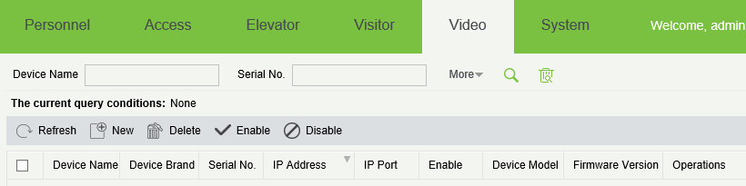
Video Linkage
* Video Linkage that can support 3rd party device
www.zkteco.me

Slide 12




Comprehensive Video Integration
Access Control and
Video Linkage
Elevator Control and
Video Linkage
www.zkteco.me

Slide 13
Support Device List
Module | Firmware Type | Devices
Access | PUSH | inBio160Pro Box; inBio260Pro Box; inBio460Pro Box
 | PULL | inBIO160 PackageB; inBIO260 PackageB; inBIO460 PackageB; TF1700(PULL)
Elevator | PULL | EC-10; EX16
Visitor | NA | Free driver USB camera
Video Linkage | NA | HIKVision IPC; NVR; DVR DS series. ZKTeco IPC: ZKIP532/ZKMD532-M06 NVR: ZKNV0804/ZK-NV0402 DVR: DS-7316HWI-SH
www.zkteco.me

Slide 14


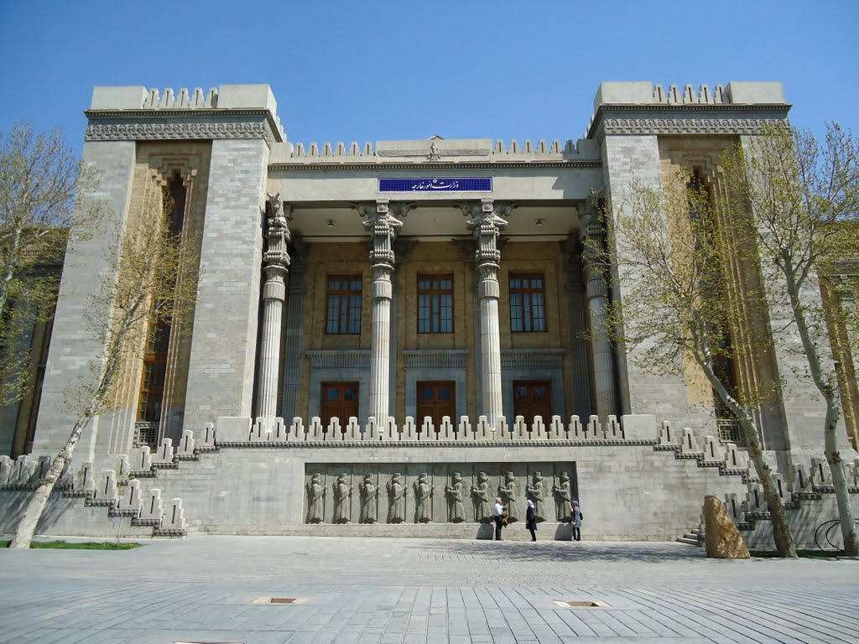



Applications
Government
Schools & Universities
Construction Sites
Chain Stores
www.zkteco.me

Slide 15

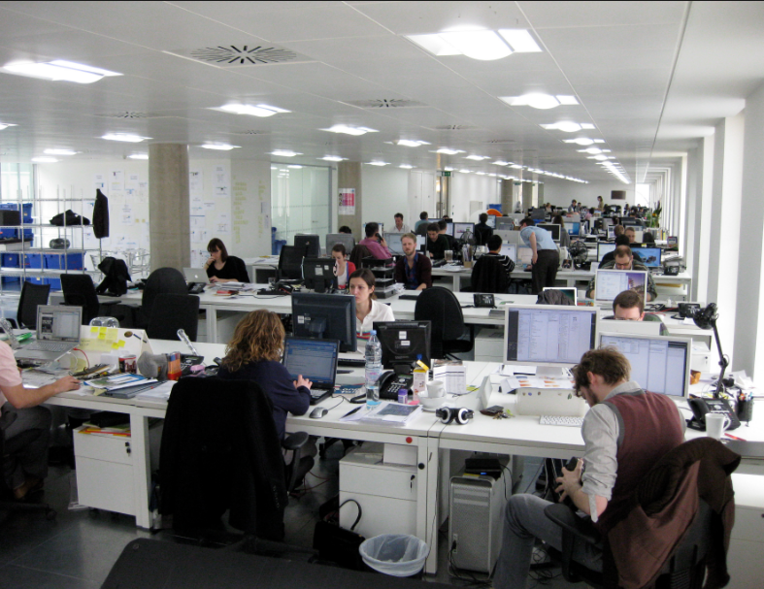
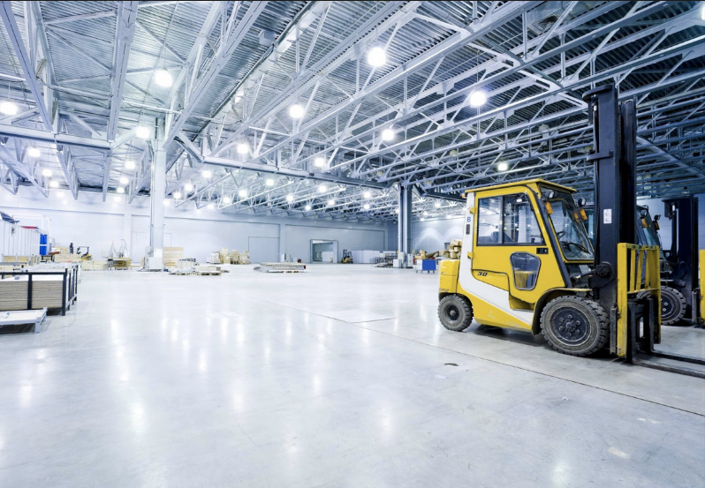
Applications
Hospitals
Commercial Offices
Retail & Logistics
www.zkteco.me

Slide 16
BioSecurity3.0 Trial
To try the software for free: Click Here
http://80.227.52.78:8088/
Username: admin
Password: admin
----------------------------------------------------------------------------------------------------------------------
To download the software: Click Here
www.zkteco.me

Slide 17
ZKTeco Middle East
P.O. Box 54823,Office 1207,Floor 112,Arenco Tower,
Media City, Sheikh Zayed Road, Dubai,U.A.E.
E-mail: zk_me@zkteco.com
www.zkteco.me

