Slide 1

BioTime 6.0
Web-Based Time Attendance Software

Slide 2
BioTime 6.0
BioTime 6.0 is a powerful web-based time attendance software that can manage thousands of time attendance terminals under complex network (WLAN).
It features a simple access control module that can now connect to ZKTeco standalone access control terminals. Another outstanding feature is the payroll module that calculate employees’ wages according to their workloads and can generate WPS report easily.
With its new user-friendly UI, managing timetable, shifting schedule, and generating attendance reports have become easily managed.
www.zkteco.me

Slide 3










Features
Web-Based Time Attendance Software
Flexible Scheduling
Payroll Management System
Automatic E-mail Alerts
Simple Access Control System
Attendance Calculation and Reports
Auto-Synchronization of Palm, Face, Finger Vein, Fingerprint, Card, and Pin Templates
WPS Report
Employee Self-Service
Real-Time Monitoring
Multiple Admin Privilege
Multi-Languages
www.zkteco.me

Slide 4



Web-based Time Attendance Software
All data will automatically transferred from device to the server
Remotely manage thousands of T&A terminals under complex network condition (WLAN)
Multiple admin can access the Web-based system anywhere
Easy to set Timetable, Shift
Easy to assign schedule
Easy to generate report
www.zkteco.me

Slide 5
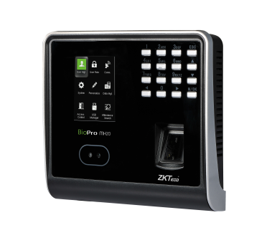
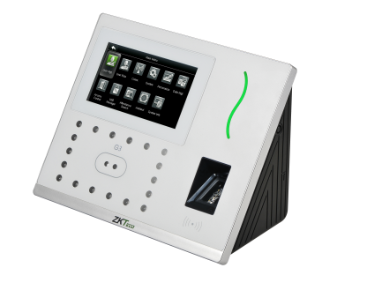
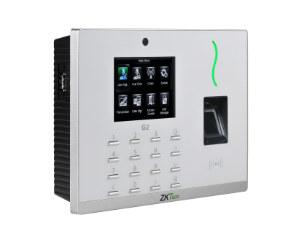
Auto-Synchronization of Attendance & Data
“Area 1”
“Area 2”
Automatically synchronizing the data between devices and server among the same “Area” to ensure the information are updated.
www.zkteco.me

Slide 6
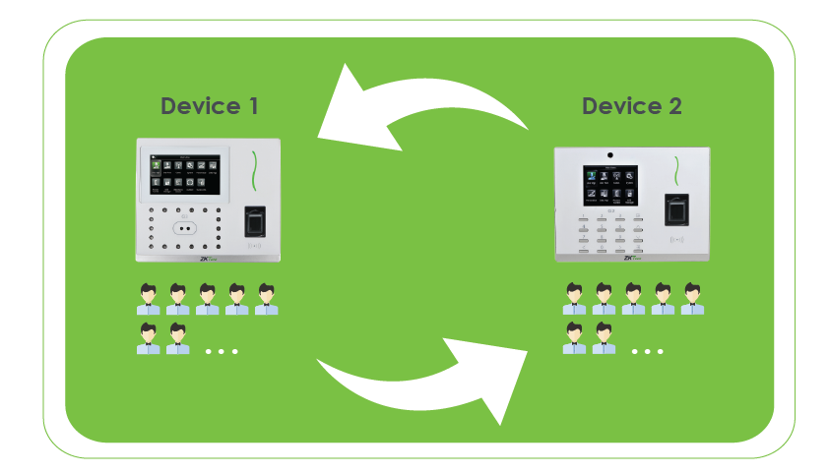
Auto-Synchronization of Attendance & Data
“Area 1”
Devices and Personnel in same “Area” will keep data synchronization.
www.zkteco.me

Slide 7
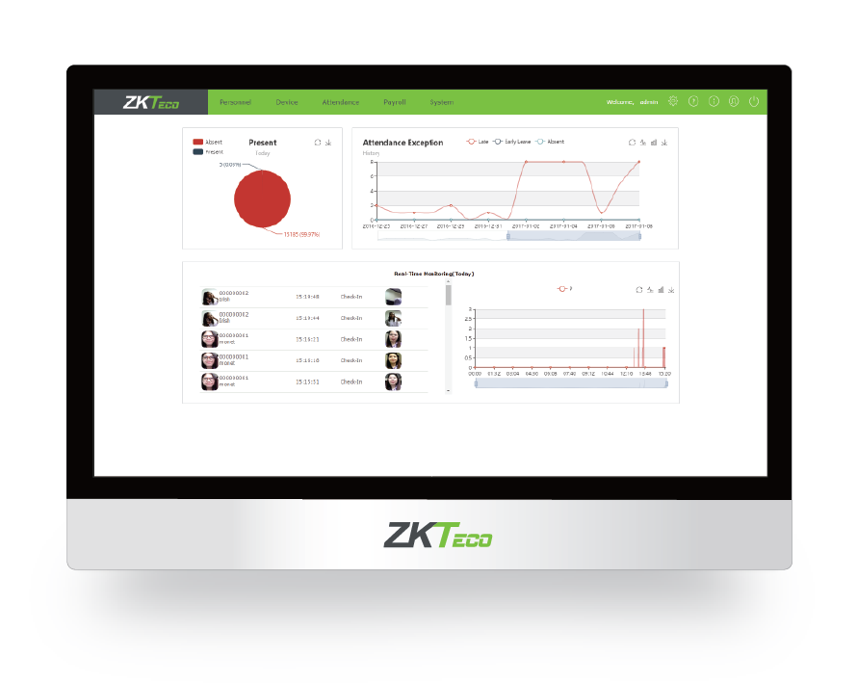
E-mail Notification Alerts
E-mail notifications are sent to employees for attendance alerts in
case of late, early leave, and absence.
www.zkteco.me

Slide 8




Employee Self-Service Enquiry
Employees can:
• Apply leave
• Apply manual punch
• Self Report Enquire
www.zkteco.me

Slide 9
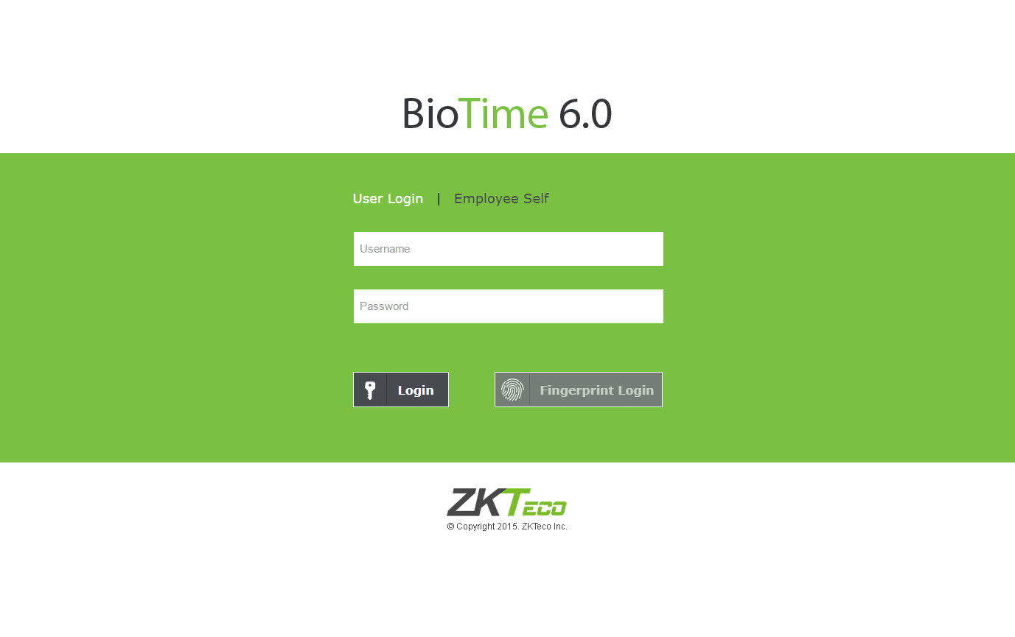
Multiple Admin Privilege
Multiple admin can be set to manage different privilege in the software. Admin will get a list of employee’s attendance including the number of late and absences.
www.zkteco.me

Slide 10
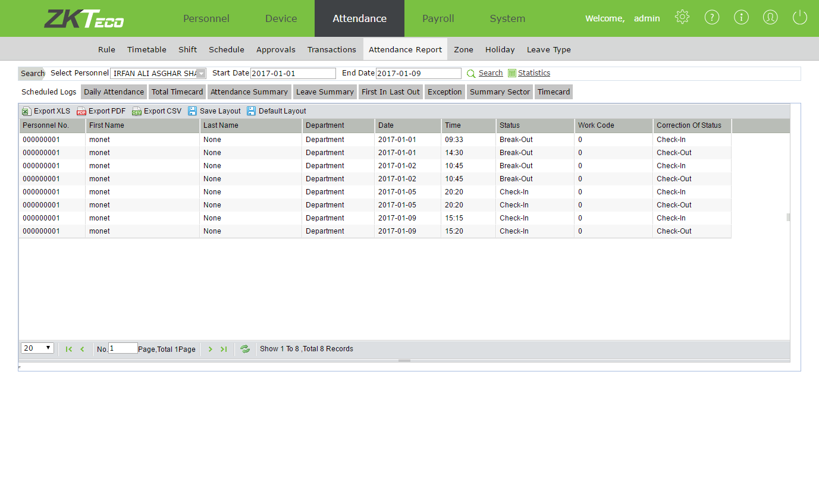
Attendance Calculation & Reports
The attendance reports are calculated easily and can be exported
in CSV, PDF, and XLS format.
www.zkteco.me

Slide 11
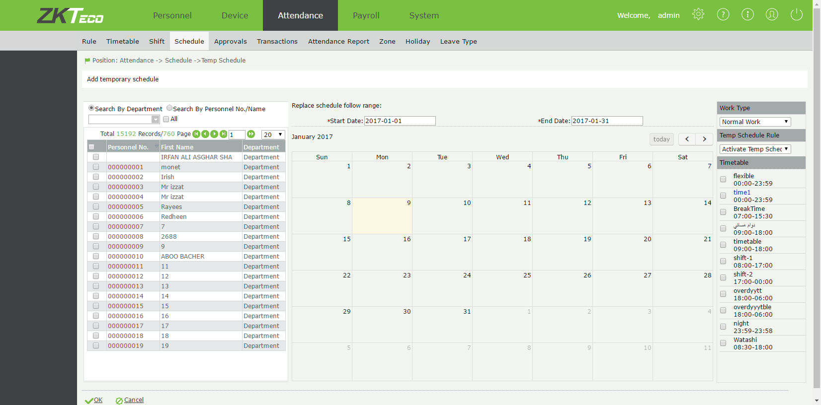
Flexible Shift Scheduling
Multiple Timetable
Cross day (24 hours) shift
Shift Cycle
Temporary Schedule
www.zkteco.me

Slide 12
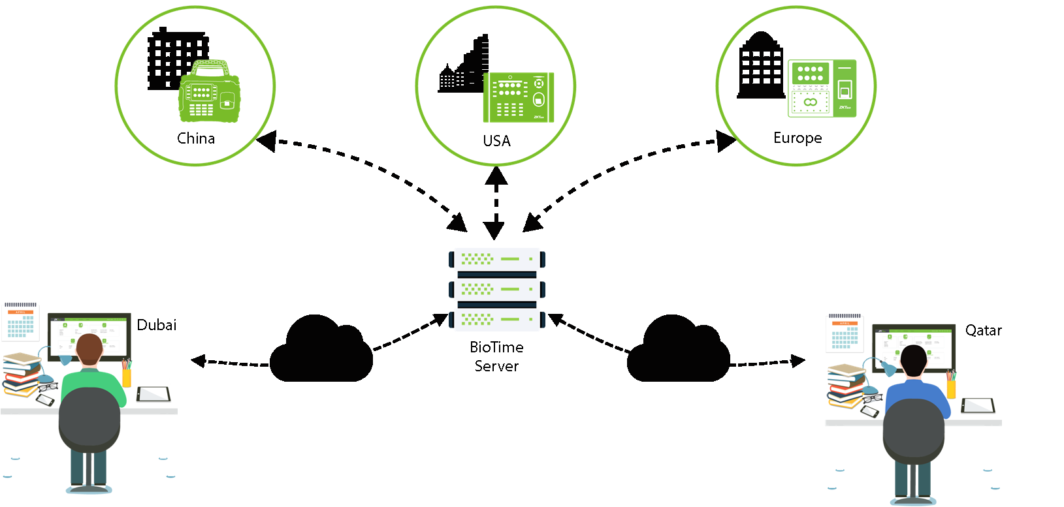
Multi-Location Centralized Management
www.zkteco.me

Slide 13
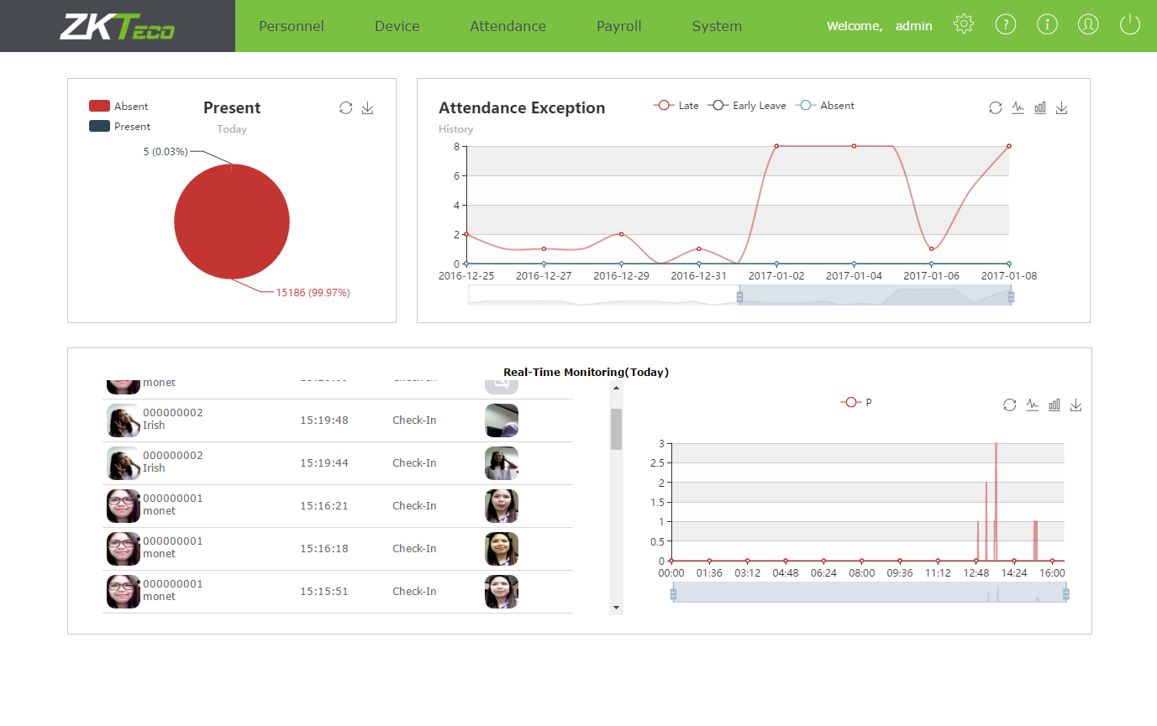
All-in-One Attendance System
Easy menu navigation
User-friendly interface
You can manage attendance, personnel, device, and payroll in one system.
www.zkteco.me

Slide 14
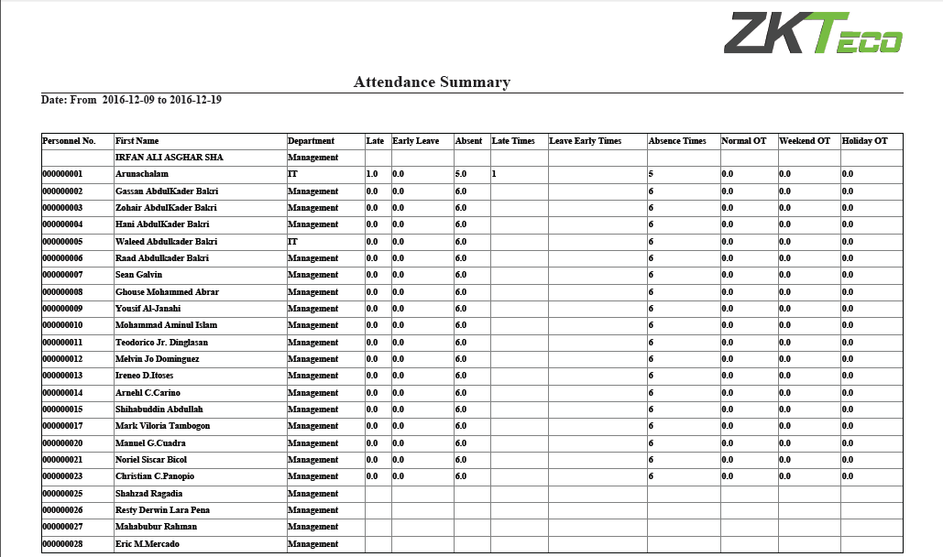
BioTime 6.0 Sample Reports
www.zkteco.me

Slide 15
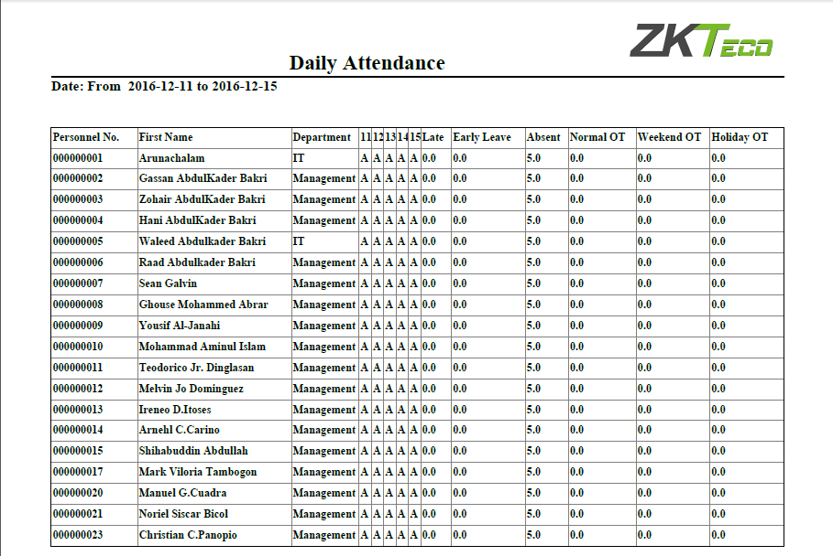
BioTime 6.0 Sample Reports
www.zkteco.me

Slide 16
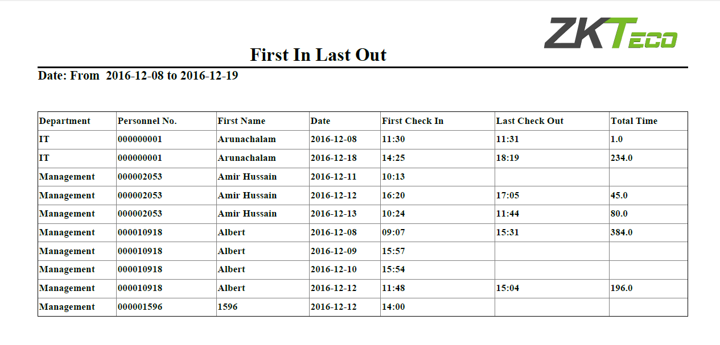
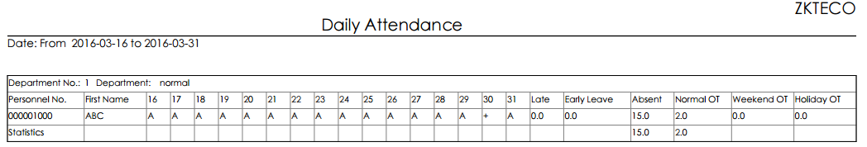
BioTime 6.0 Sample Reports
www.zkteco.me

Slide 17
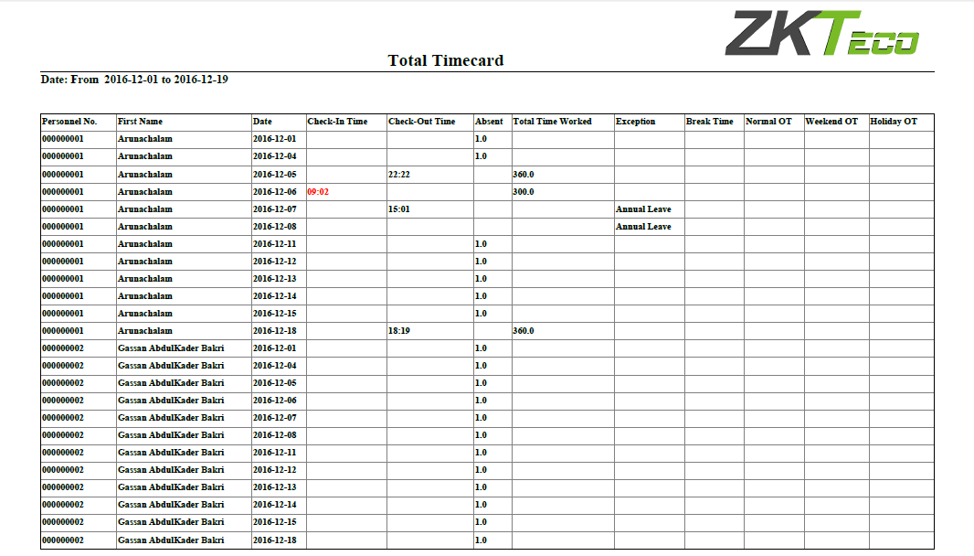
BioTime 6.0 Sample Reports
www.zkteco.me

Slide 18
Technical Specification
Items | Support
Templates | Palm / Finger Vein / Face / Fingerprint / RFID / Pin
Server | Windows 7,Windows 8/8.1, Windows Server 2008/2012
Network | TCP/IP / Wi-Fi / GPRS / 3G / 4G
Protocol | Push SDK(Push Protocol)
Browser | IE 11+ / Firefox 27+ / Chrome 33+
Database | MS SQL Server 2005/2008 (Recommended) / MySQL / Oracle 10g/11g
www.zkteco.me

Slide 19
Hardware Requirement
Items | Support
 | 100 Devices | 200 Devices | 500 + Devices
CPU | Intel i3 Quad Core | Intel i5 Magny-Cours | Intel i7 Magny-Cours
RAM | 4G | 8G | 16G
Storage | Available space of 100G or above. (We recommend using NTFS hard disk partition as the software installation directory)
OS | Windows 7/8/Server 2003/Server 2008 -32Bit & 64Bit
Monitor Resolution | 1024*768px or above
www.zkteco.me

Slide 20


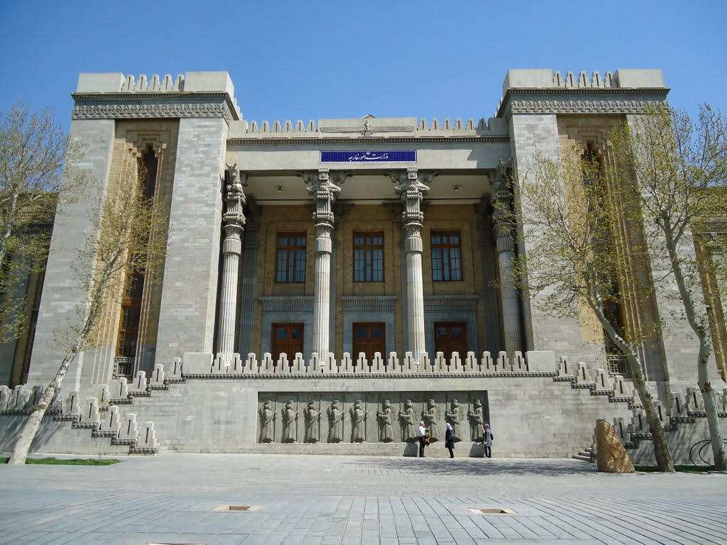



Applications
Government
Schools & Universities
Construction Sites
Chain Stores
www.zkteco.me

Slide 21

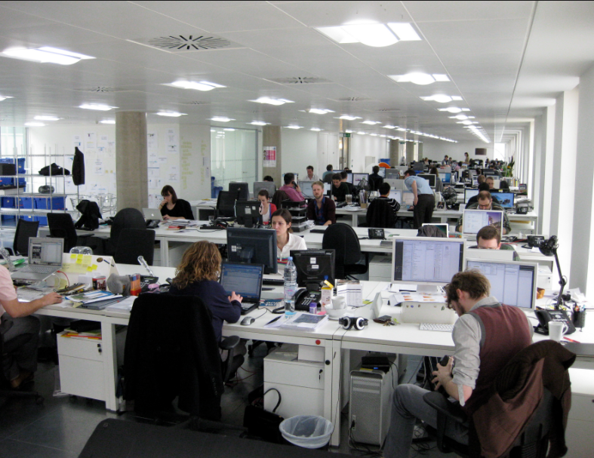

Applications
Hospitals
Commercial Offices
Retail & Logistics
www.zkteco.me

Slide 22





























Successful Projects
www.zkteco.me

Slide 23
BioTime 6.0 Trial
To try the software for free: Click Here
http://80.227.52.78:8080/accounts/login/
Username: admin
Password: admin
----------------------------------------------------------------------------------------------------------------------
To download the software: Click Here
www.zkteco.me

Slide 24
ZKTeco Middle East
P.O. Box 54823,Office 1207,Floor 112,Arenco Tower,
Media City, Sheikh Zayed Road, Dubai,U.A.E.
E-mail: zk_me@zkteco.com
www.zkteco.me

